Slide 1
DIGITAL LIBRARY MANAGEMENT SYSTEM
V.BALAKRISHNA 19189-CM-018
S.GOWTHAM 19189-CM-014
D. KRUTHIKA 19189-CM-021
G.ANIL KUMAR 19189-CM-035
CH.VENKATESH 19189-CM-024
G.SAITEJA 19189-CM-025
V.RUPESH NAIK 19189-CM-019
P.RAKESH 19189-CM-037

Slide 2
INTRODUCTION
The project titled Library Management System is Library Management software for monitoring and controlling the transactions in a library .The project “Library Management System” is developed in php, which mainly focuses on basic operations in a library like adding new books, and updating new information, searching books and members and return books.
Throughout the project the focus has been on presenting information and comments in an easy and intelligible manner. The project is very useful for those who want to know about Library Management System.

Slide 3
ABSTRACT
The Library Management System is an application for assisting a librarian in managing a book library in a university. The system would provide basic set of features to add/update members, add/update books, and manage check in specifications for the systems based on the client’s statement of need.
Library management system is a typical management Information system (MIS), its Development include the establishment and maintenance of back-end database and front-end application development aspects. For the former require the establishment of data consistency and integrity of the strong data security and good libraries. As for the latter requires the application fully functional, easy to use and so on.

Slide 4
EXISTING SYSTEM
System and their relationships within and outside of the system. Here the key question is- what all problems exist in the present system? What must be done to solve the problem? Analysis begins when a user or manager begins a study of the System Analysis is a detailed study of the various operations performed by a program using existing system. During analysis, data collected on the various files, decision points and transactions handled by the present system. The success of the system depends largely on how clearly the problem is defined, thoroughly investigated and properly carried out through the choice of solution. A good analysis model should provide not only the mechanisms of problem understanding but also the frame work of the solution. Thus it should be studied thoroughly by collecting data about the system. Then the proposed system should be analyzed thoroughly in accordance with the needs.

Slide 5
PROPOSED SYSTEM
The students will register them through Online.
Individually each member will have his account through which he can access the information he needs.
Book details like authors, number of copies totally maintained by library, present available number of books, reference books, non-reference books etc. all this information can be made handy.
Regarding the members designation, number of books was issued.
Issue dates and returns of each member is maintained separately and fine charged if there is any delay in returning the book.
Librarian can add, update the books.
Time consuming is low, gives accurate results, reliability can be improved withϒ the help of security.

Slide 6
SYSTEM REQUIRMENTS
HARDWARE REQUIREMENTS:
Processor : Pentium IV
Speed : 2.4 GHz
RAM : 256 MB
Hard Disk : 40 GB
Key Board : Standard Windows Keyboard
Monitor : 15 VGA Color
Mouse : Two or Three Button Mouse
SOFTWARE REQUIREMENTS:
Operating system : Windows 7 Ultimate
Coding Language : PHP
Front-End : HTML, CSS, JavaScript, BootStrap.
Back End : PHP, MySQL

Slide 7
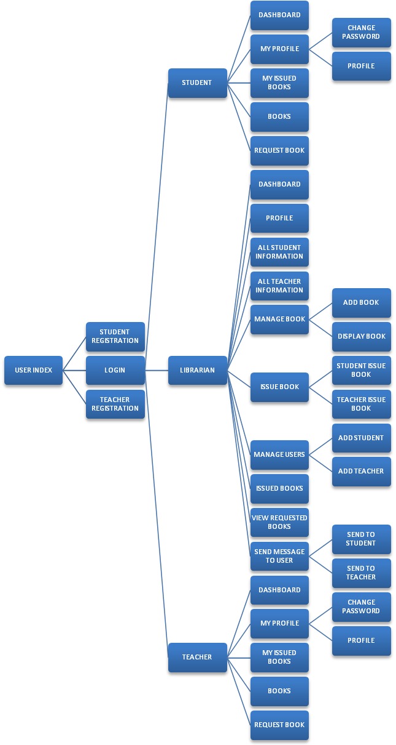
DIAGRAM

Slide 8
TECHNOLOGIES USED
HTML- HTMLorHyper Text Markup Language the main markup language for creating web pages and other information that can be displayed in a web browser.HTML is written in the form of HTML elements consisting of tags enclosed in angle brackets (like ), within the web page content. HTML tags most commonly come in pairs like and, although some tags represent empty elements and so are unpaired, for example Error! Filename not specified.. The first tag in a pair is the start tag, and the second tag is the end tag (they are also called opening tags and closing tags).

Slide 9
CSS- Cascading Style Sheets(CSS) is a style sheet language used fordescribing the look and formatting of a document written in a markup language. While most often used to style web pages and interfaces written in HTML and XHTML, the language can be applied to any kind of XML document, including plain XML, SVG and XUL. CSS is a cornerstone specification of the web and almost all web pages use CSS style sheets to describe their presentation.
JAVA SCRIPT- JavaScript(JS) is a dynamic computer programminglanguage. It is most commonly used as part of web browsers, whose implementations allow clientside scripts to interact with the user, control the browser, communicate asynchronously, and alter the document content that is displayed. It is also being used in server-side programming, game development and the creation of desktop and mobile applications.

Slide 10
PHP- PHPis a server-side scripting language designed for webdevelopment but also used as a general-purpose programming language. PHP is now installed on more than 244 million websites and 2.1 million web servers. Originally created by Rasmus Lerdorf in 1995, the reference implementation of PHP is now produced by The PHP Group. While PHP originally stood for Personal Home Page, it now stands for PHP: HypertextPreprocessor, a recursive backronym.PHP code is interpreted by a webserver with a PHP processor module, which generates the resulting web page: PHP commands can be embedded directly into an HTML source document rather than calling an external file to process data.

Slide 11
MYSQL- MySQL("My S-Q-L", officially, but also called "My Sequel") is (as ofJuly 2013) the world's second most widely used open-source relational database management system (RDBMS). It is named after co-founder Michael Widenius daughter, My. The SQL phrase stands for Structured Query Language. The MySQL development project has made its source code available under the terms of the GNU General Public License, as well as under a variety of proprietary agreements. MySQL was owned and sponsored by a single for-profit firm, the Swedish company MySQL AB, now owned by Oracle Corporation .MySQL is a popular choice of database for use in web applications, and is a central component of the widely used LAMP open source web application software stack (and other 'AMP' stacks). LAMP is an acronym for "Linux, Apache, MySQL, Perl/PHP/Python.

Slide 12
IMPLEMENTATION
Implementation
The implementation phase is less creative than system design. It is primarily concerned with user training, and file conversion. The system may be requiring extensive user training The initial parameters of the system should be modifies as a result of a programming. A simple operating procedure is provided so that the user can understand the different functions clearly and quickly. The different reports can be obtained either on the inkjet or dot matrix printer, which is available at the disposal of the user.
The proposed system is very easy to implement. In general implementation is used to mean the process of converting a new or revised system design into an operational one.

Slide 13
TESTING
Testing:-
Testing is the process where the test data is prepared and is used for testing the modules individually and later the validation given for the fields. Then the system testing takes place which makes sure that all components of the system property functions as a unit. The test data should be chosen such that it passed through all possible condition. Actually testing is the state of implementation which aimed at ensuring that the system works accurately and efficiently before the actual operation cominence.

Slide 14
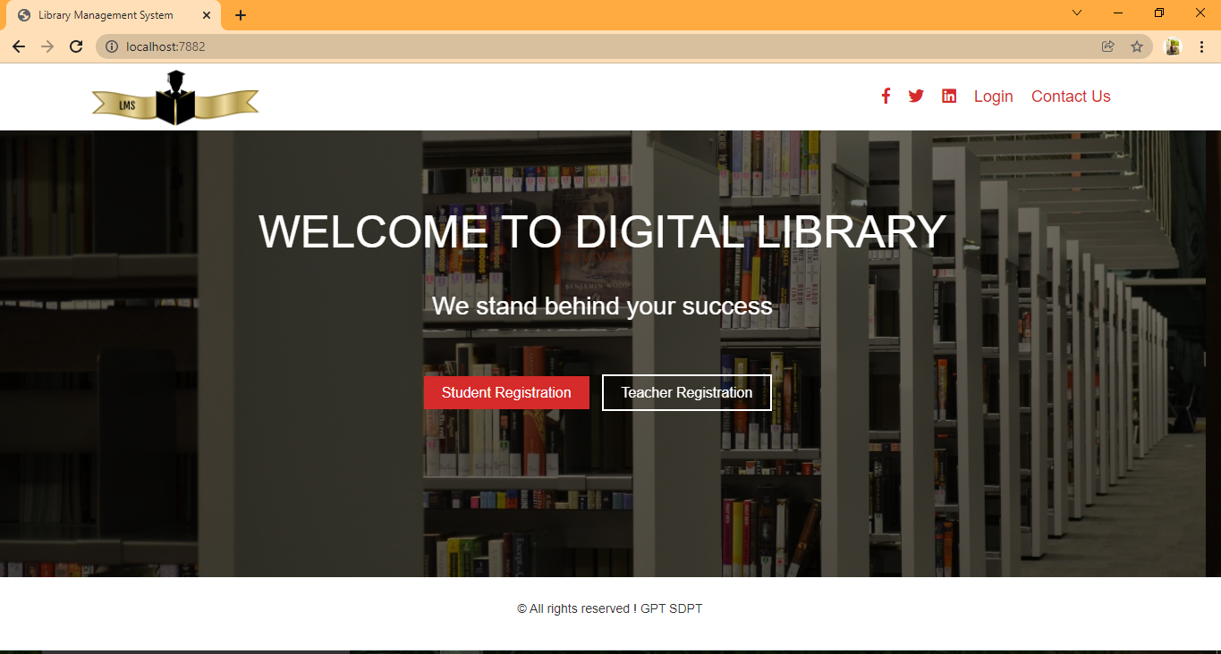
SCREENSHOTS

Slide 15
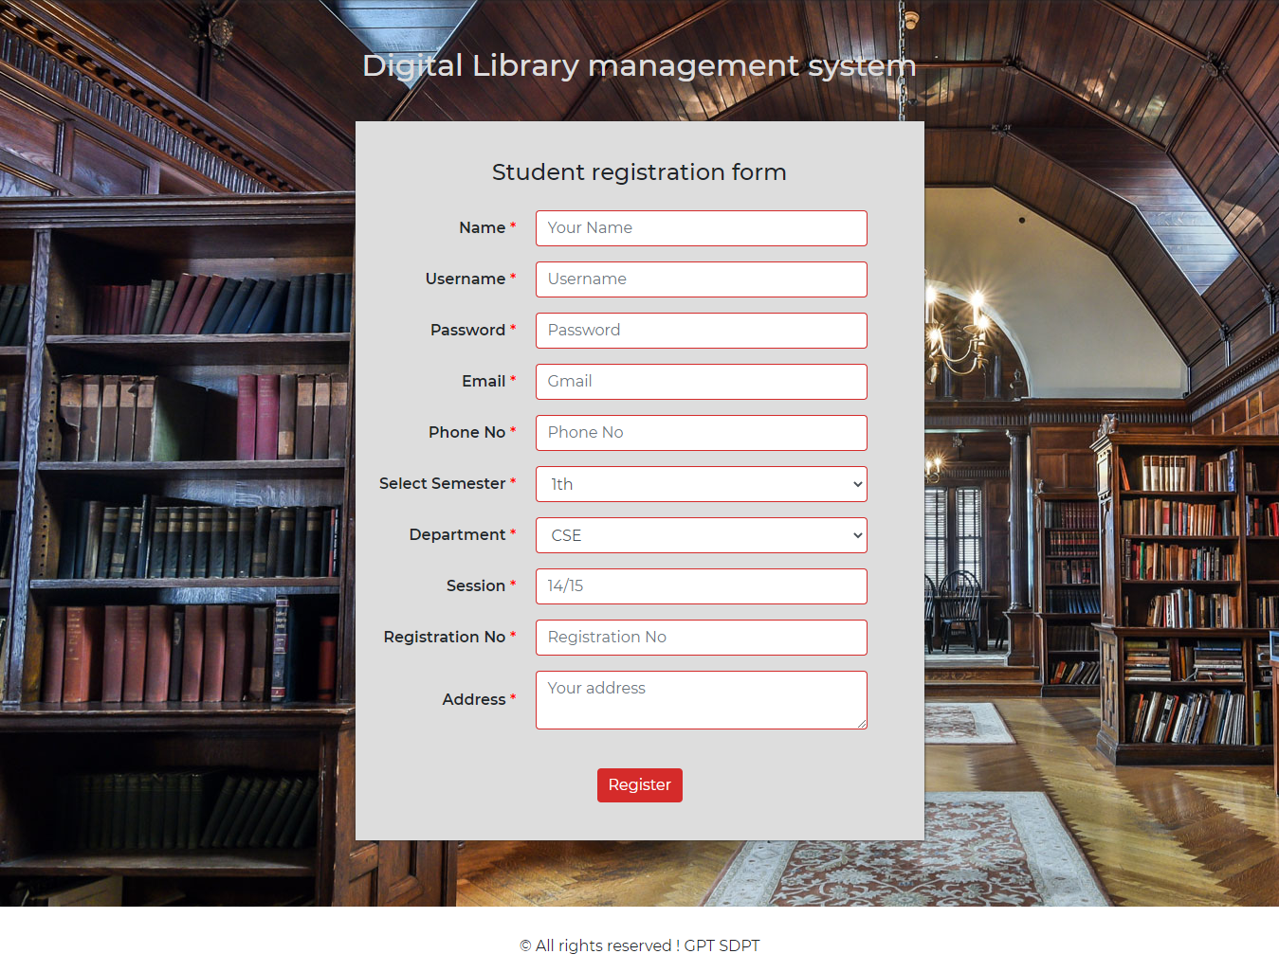
STUDENT REGISTRATION

Slide 16
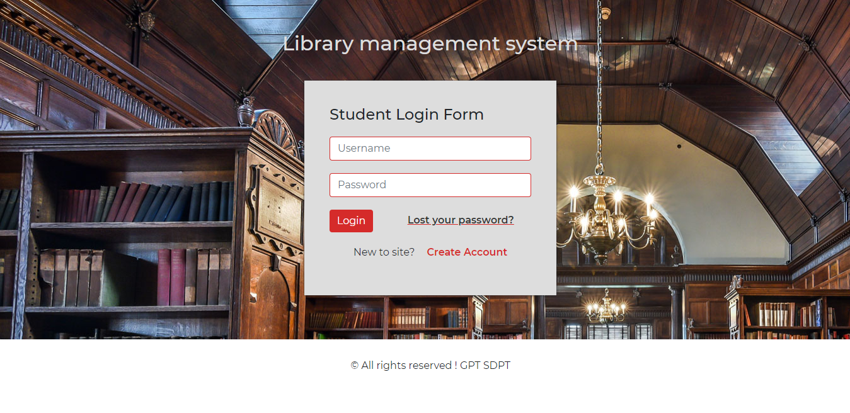
STUDENT LOGIN

Slide 17
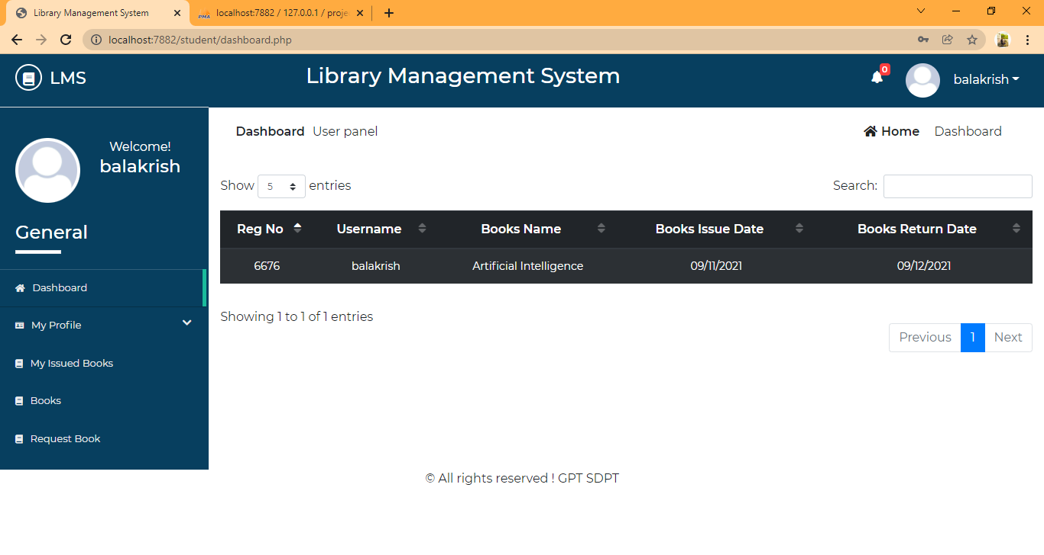
STUDENT DASHBOARD

Slide 18
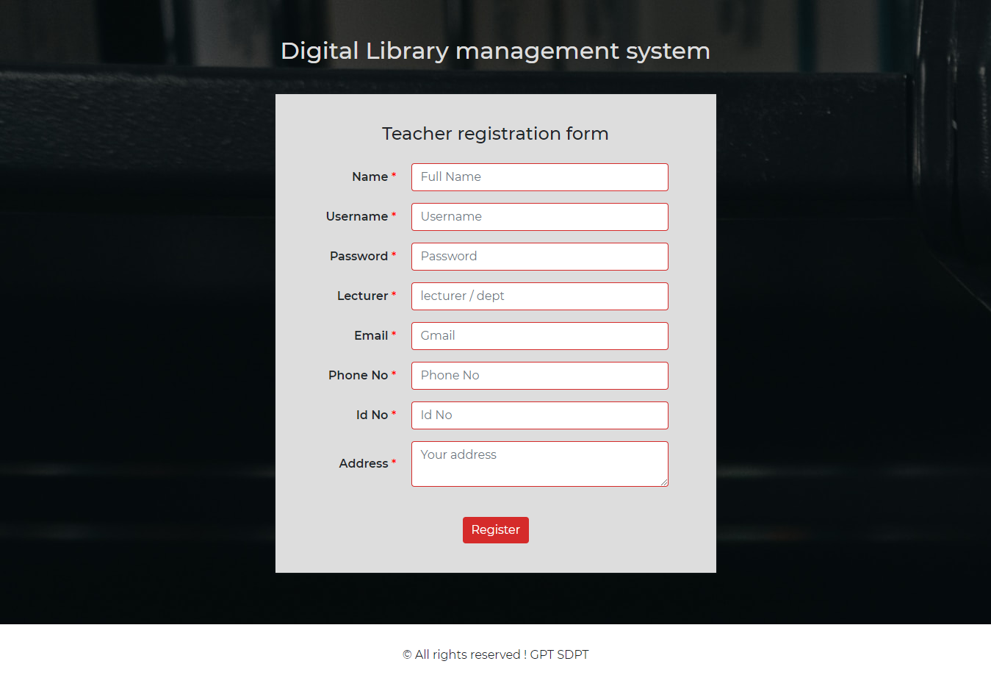
TEACHER REGISTRATION

Slide 19
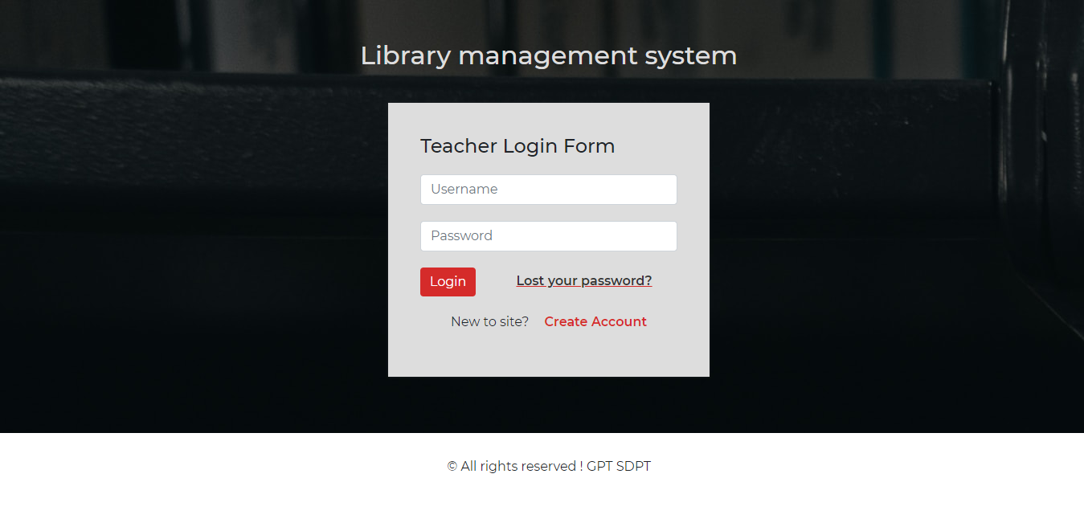
TEACHER LOGIN

Slide 20
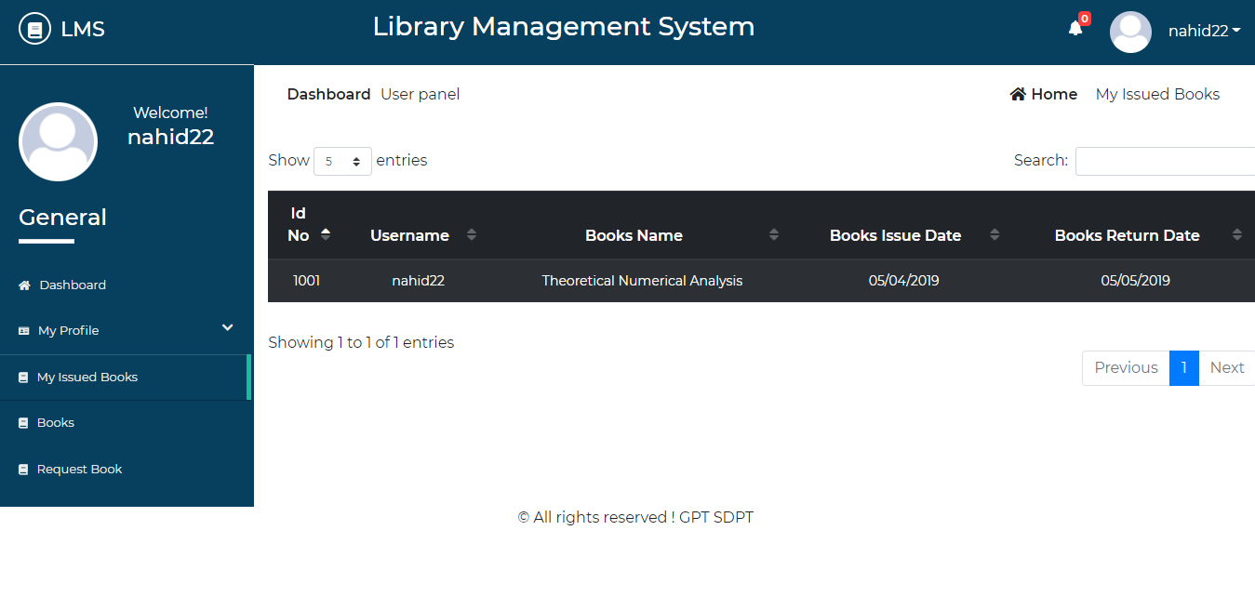
TEACHER DASHBOARD

Slide 21
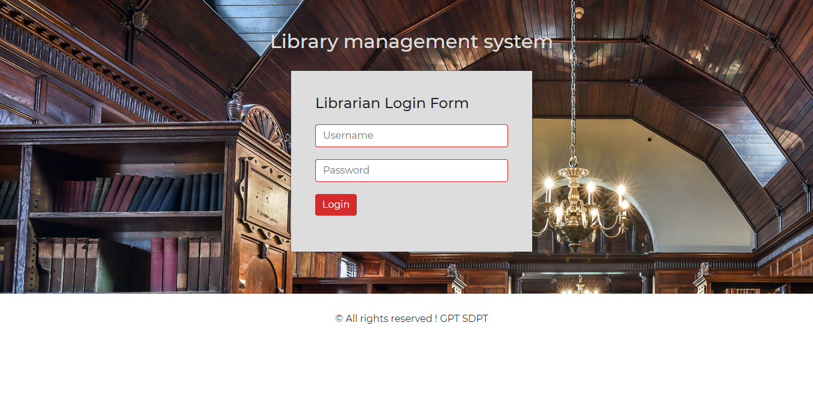
LIBRARIAN LOGIN

Slide 22
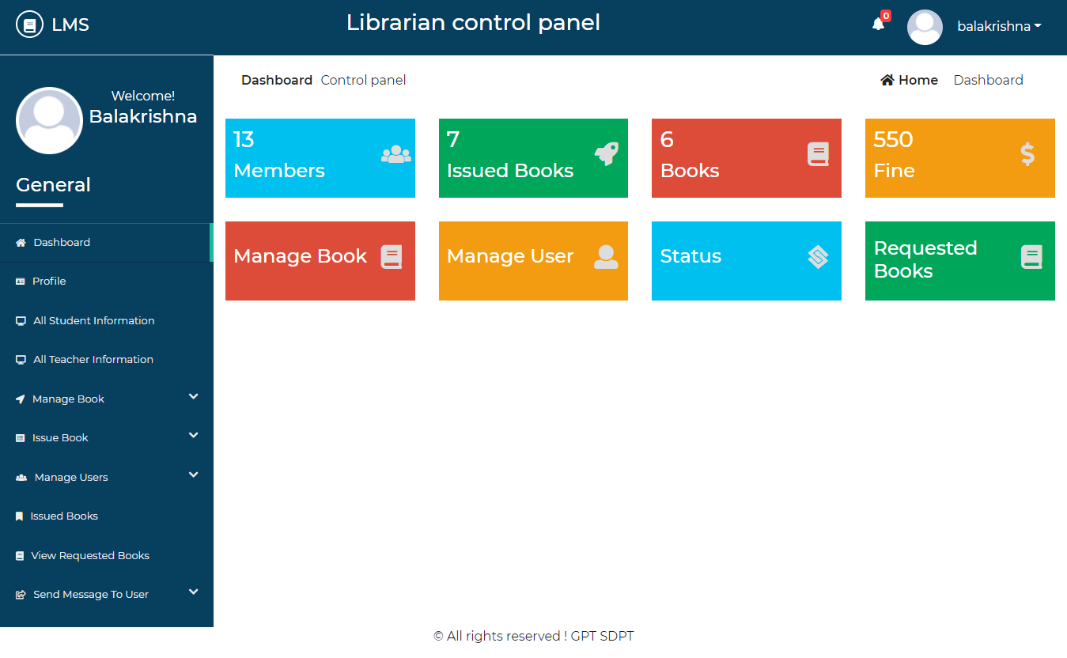
LIBRARIAN DASHBOARD

Slide 23
CONCLUSION AND FUTURE SCOPE
This website provides a computerized version of library management system which will benefit the students as well as the staff of the library. It makes entire process online where student can search books, staff can generate reports and do book transactions. It also has a facility for student login where student can login and can see status of books issued as well request for book or give some suggestions. It has a facility of teacher’s login where teachers can add lectures notes and also give necessary suggestion to library and also add info about workshops or events happening in our college or nearby college in the online notice board. There is a future scope of this facility that many more features such as online lectures video tutorials can be added by teachers as well as online assignments submission facility , a feature Of group chat where students can discuss various issues of engineering can be added to this project thus making it more interactive more user friendly and project which fulfills each users need in the best way possible.

Slide 24
THANK YOU

